Slide 1
GoodCab: Insights 2024
Comprehensive analysis of trips, passengers, drivers and revenue

Slide 2
Objectives
1. City-level fare and trip summary
2. Monthly city-level trips target performance
3. Repeat passenger trip frequency
4. Cities with the highest/lowest new passengers
5. The month with the highest revenue
6. Repeat passenger rate analysis

Slide 3
Key Metrics Overview
• Total Revenue: ₹108M
• Total Passengers: 238K
• Total Trips: 426K

Slide 4
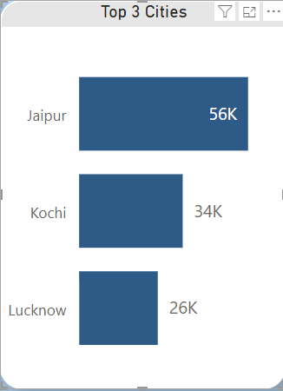
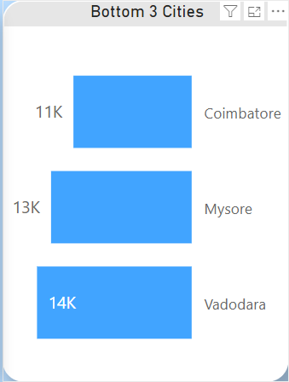
Top and Bottom Cities by Trips
Jaipur > Kochi > Lucknow Coimbatore < Mysore < Vadodara

Slide 5
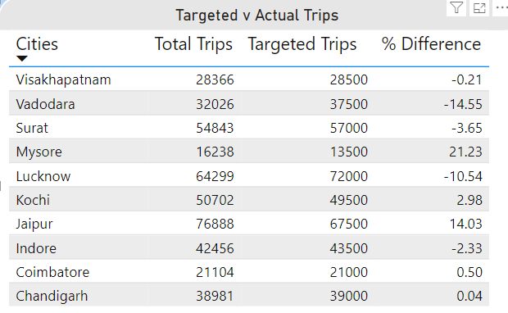
Target vs Actual Performance
• Mysore exceeded targets by 21.23%
• Vadodara fell short by 14.55%

Slide 6

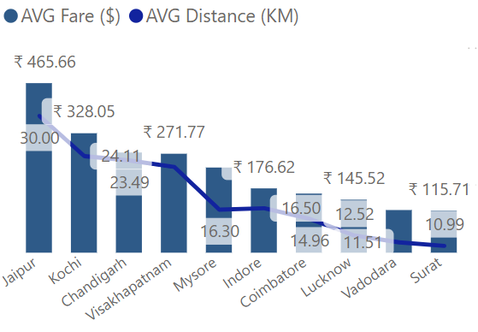
Fare and Distance Analysis
• Highest fare per trip: Jaipur (₹ 483.92)
• Lowest fare per trip: Surat (₹ 117.27)

Slide 7
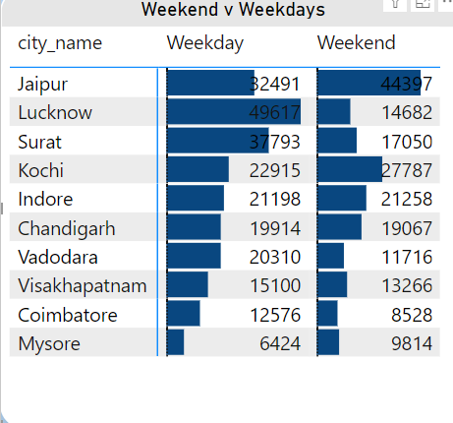
Weekend vs Weekday Trips
 | Weekday | Weekend
Highest | Lucknow | Jaipur
Lowest | Mysore | Coimbatore
.

Slide 8
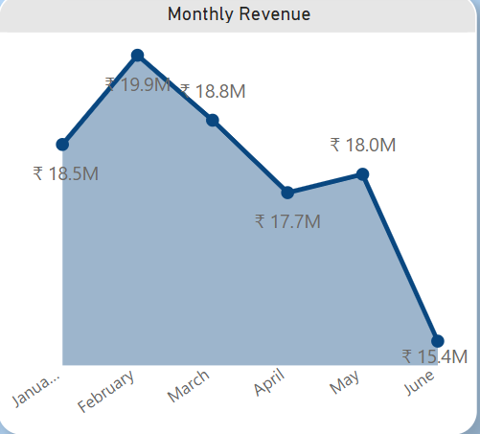
Monthly Trends
• Peak revenue: February ($19.9M)
• Decline from Feb ($19.9M) to June ($15.4M)
Although a good sign in May.

Slide 9
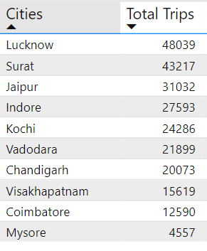
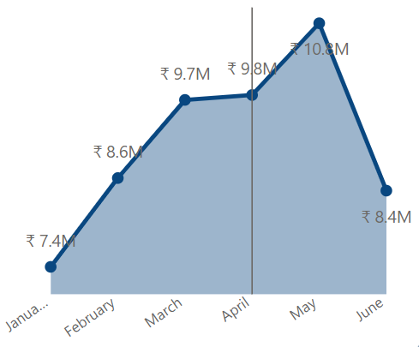
Repeat Passenger Analysis
Lucknow > Surat > Jaipur are the top three cities with the highest repeat passenger rate
Monthly Revenue increases from Jan to May and drops in June
.

Slide 10
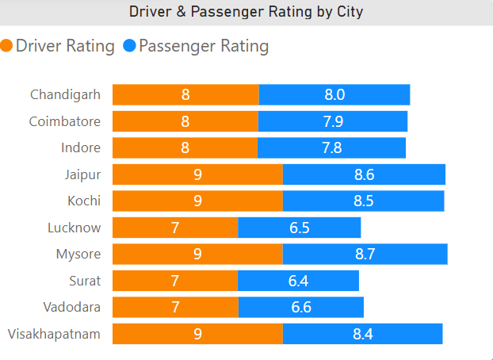
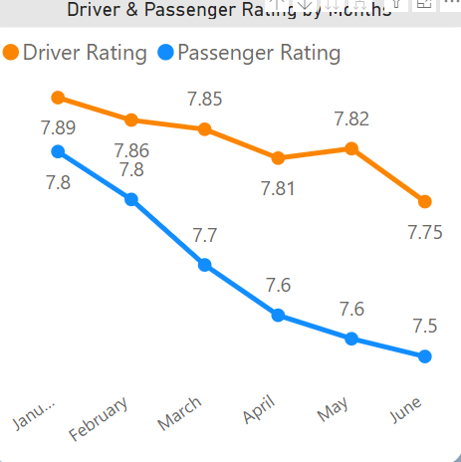
Passenger and Driver Ratings
Average Driver and Passenger Rating by cities
Driver and Passenger Rating Trends

Slide 11
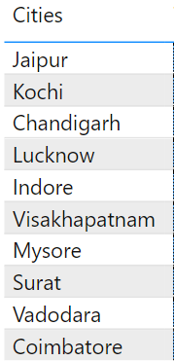
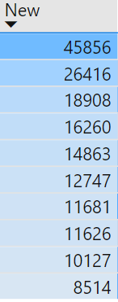
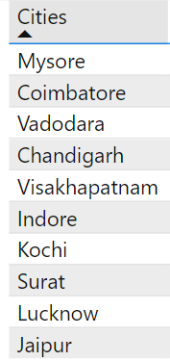
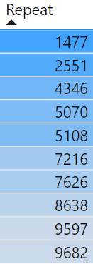
Passenger Numbers by Type
New Passengers
Repeated Passengers

Slide 12
Passenger Ratings by Type
 | Highest | Lowest
Repeated | Jaipur (8.6) | Lucknow (7.25)
New | Kochi (8.5) | Surat, Mysore (7.0)

Slide 13
Conclusions and Recommendations
• Focus on cities with low passenger rates for growth
• Leverage high-revenue months for promotions
• Enhance loyalty programs in top-performing cities

